Slide 1


Slide 2
Safer health care facilities through WASH and infection prevention and control
Strengthening Primary Health Care a hook for advancing Universal Health Coverage, Quality of Care and WASH in health care facilities?

Slide 3
Agenda
Time | Topics and speakers
1.45 | Welcome and framing
1.50 | Strengthening Primary Health Care a hook for advancing Universal Health Coverage, Quality of Care and WASH in health care facilities? Re-orienting health systems to strengthen a Primary Health Care approach - Dr. Jo Keatinge – Health Systems Expert – FCDO - UK Accelerating action on WASH in health care facilities: a key lever for universal Primary Health Care - Bruce Gordon – WASH Unit Team Leader, WHO Multi-sector collaboration – opportunities and challenges: a national level perspective - Khadija Haroun – Regional Health Officer - Tanzania Resilient health care facilities: levers and actors for change: - Neha Mankani – Midwife - Pakistan
2.20 | Prioritisation and actions that lead to systemic and sustained change: Who needs to do what in which part of the system? In groups
2.45 | Health and WASH actions for accelerating progress and sustaining WASH in healthcare facilities Close

Slide 4
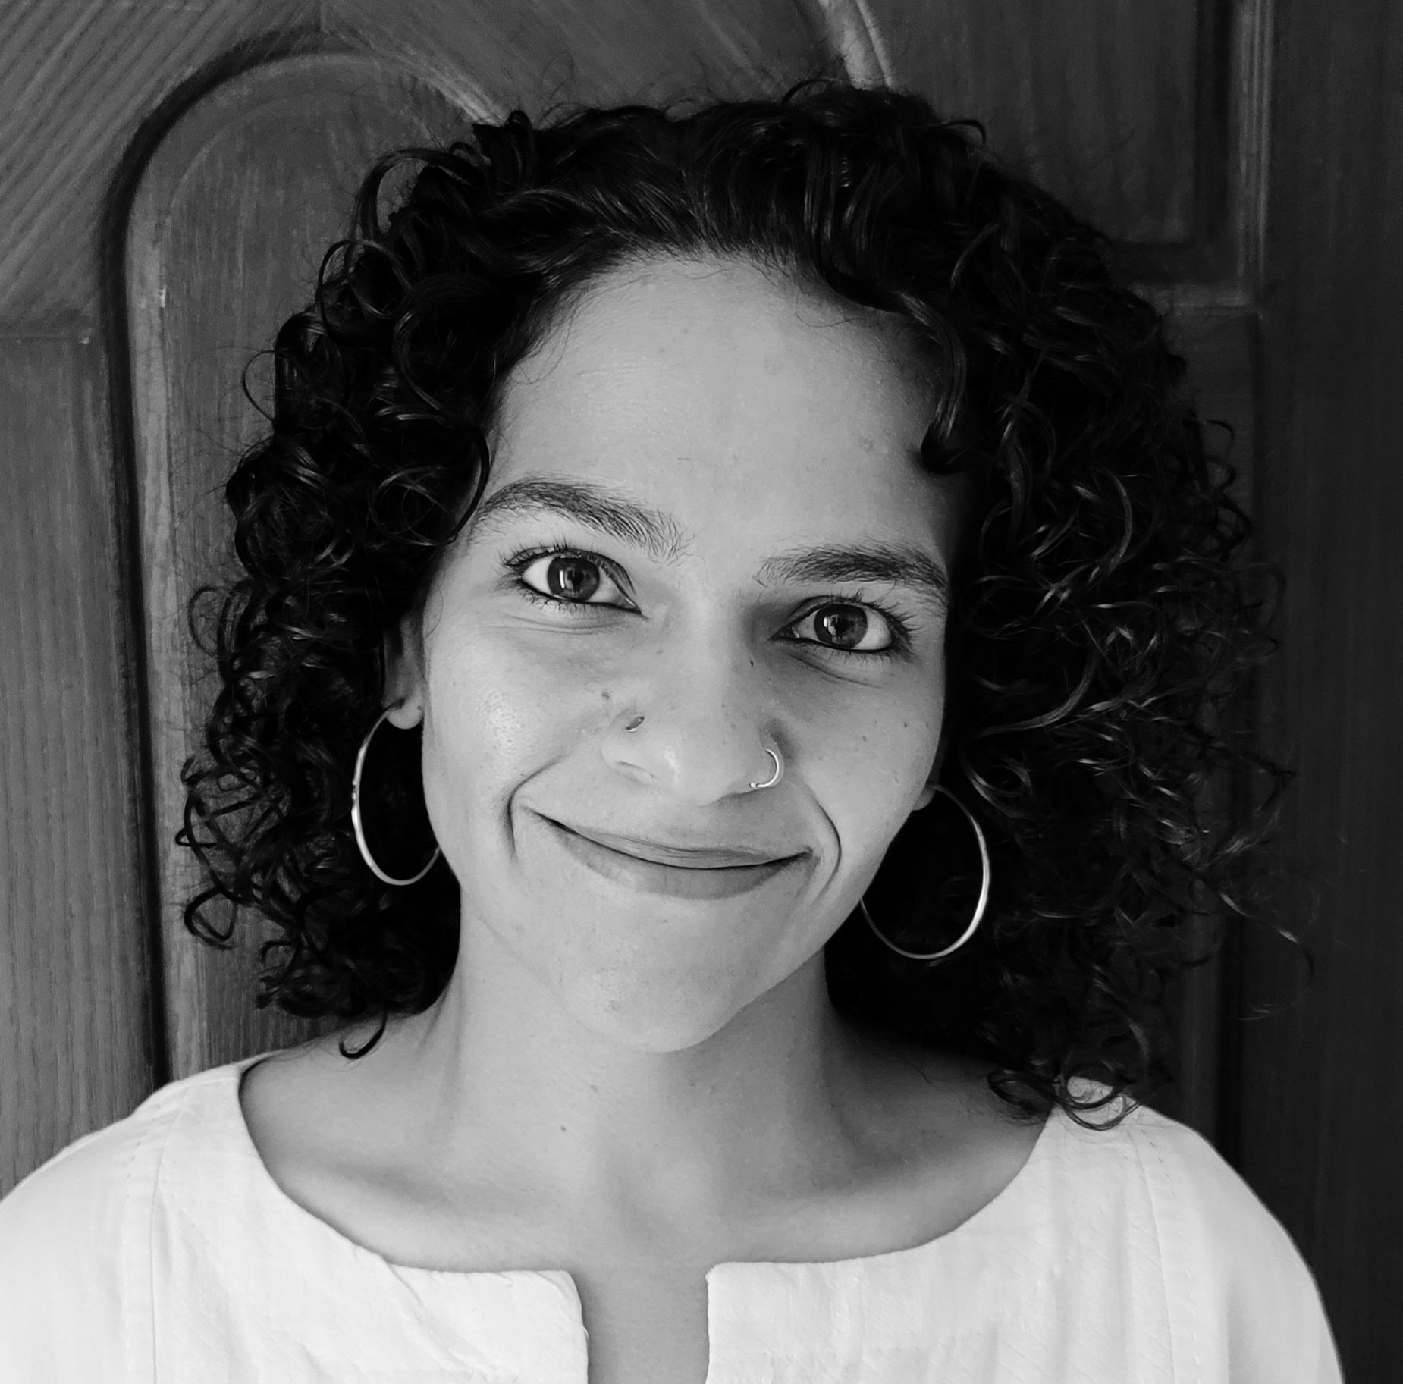
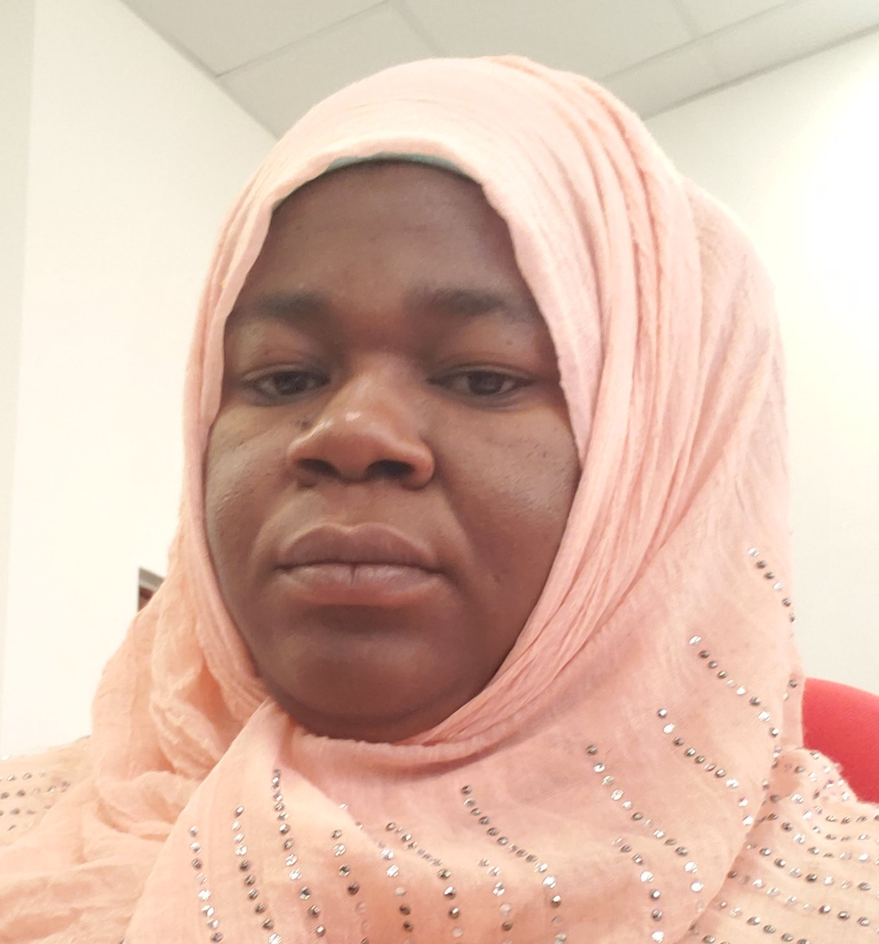
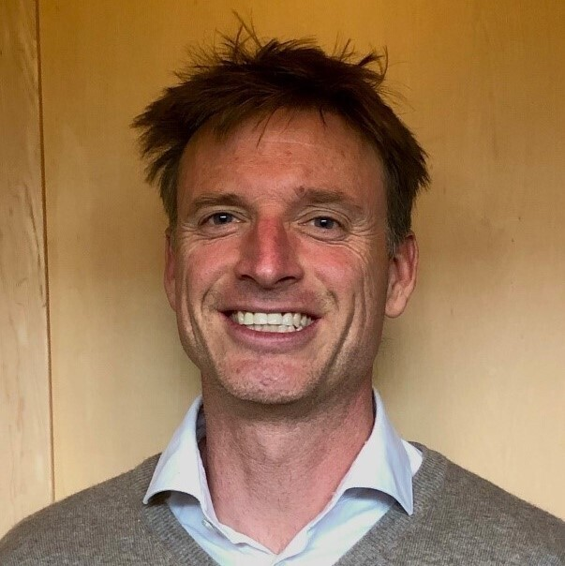

Section 1
Strengthening Primary Health Care a hook for advancing Universal Health Coverage, Quality of Care and WASH in Health Care Facilities?
Neha Mankani, Global Health Practitioner and Midwife, Pakistan
Khadija Haroun, Regional Health Officer, Tanzania
Bruce Gordon, Head of WASH Unit, WHO, Geneva
Jo Keatinge, Health Systems Strengthening Adviser, FCDO, UK

Slide 5
Universal Health Coverage – UHC
WHO definition:
All people have access to the health services they need, when and where they need them, without financial hardship.
It includes the full range of essential health services, from health promotion to prevention, treatment, rehabilitation, and palliative care.

Slide 6
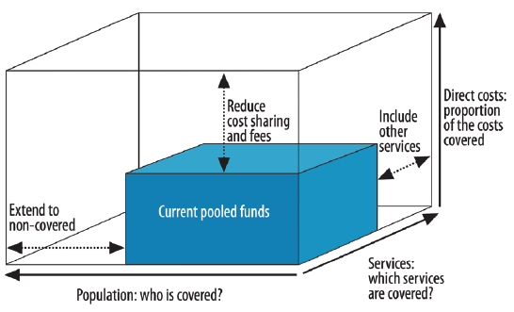
Universal Health Coverage - UHC
3 dimensions to its achievement:
Increasing population coverage – equity
Increasing quality and package of services
Reducing the financial burden for households

Slide 7
Anyone remember how we measure UHC?
UHC index + Financial Protection (catastrophic health spend)
Reproductive, maternal, newborn and child health:
Family planning
Antenatal and delivery care
Full child immunization
Health-seeking behaviour for pneumonia.
Infectious diseases:
Tuberculosis treatment
HIV antiretroviral treatment
Use of insecticide-treated bed nets for malaria prevention
Adequate sanitation.
Noncommunicable diseases:
Prevention and treatment of raised blood pressure
Prevention and treatment of raised blood glucose
Cervical cancer screening
Tobacco (non-)smoking.
Service capacity and access:
Basic hospital access – OPD visits
Health worker density
Access to essential medicines
Compliance with the IHR
Notes:
And yes team nutrition, we are working with you to have your absence here addressed!

Slide 8
Whether talking about achieving UHC or Universal access to WASH – both are reliant on strong health systems
Universal Health Coverage:
Depends on strong, resilient and equitable health systems
  Improving coverage of health services to reach those that currently don’t have access
  Increasing the quality and package of health services delivered in a more integrated way
  Making sure people are not pushed into poverty because of the costs of health services
Universal Access to WASH:
Depends on strong, resilient and equitable WASH systems
  Improving coverage of WASH services, including to those who don’t have access
  Ensuring sustainable services that are safely managed
  Affordability of services and equity

Slide 9
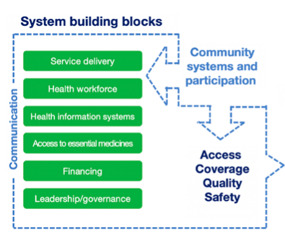
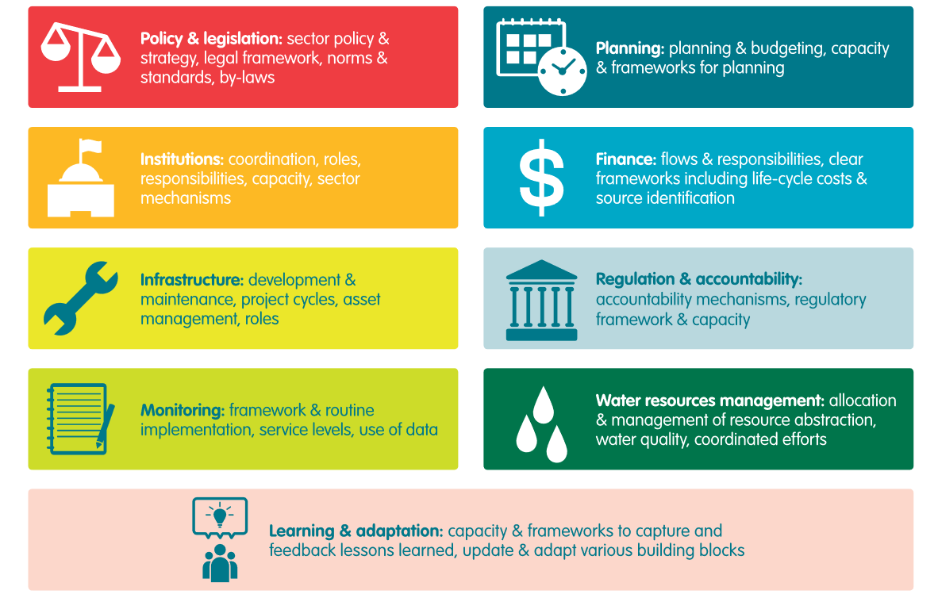
Health and WASH Building blocks

Slide 10
But why aren’t these more joined up?
Competition for resources and bandwidth - need to work together around common goals, find the ‘hooks’ where there is mutual benefit
Work in siloes - need to join up conversations between different sectors and coordinate activities better
Lack of focus on integration – need to look at commonalities, and build on existing functions and systems
Not always speaking the same language – need to understand where others are coming from – think politically not just technically, keep it simple, tailor messages to the right audience
Not always speaking to the right people – need to reach out to different stakeholders, at different levels, build trust and relationships, involve communities

Slide 11
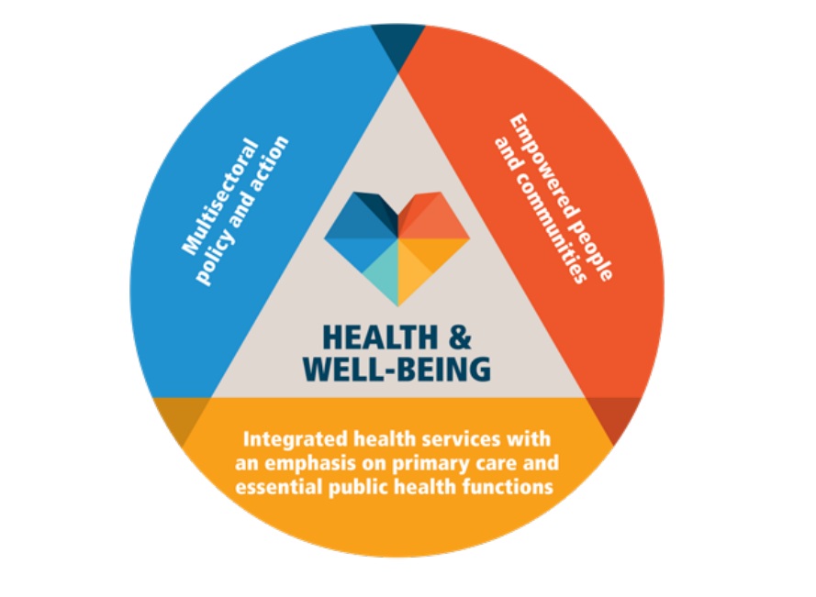
Primary Health Care is a good example of where this all comes together
PHC APPROACH
PHC LEVERS
PHC RESULTS
Improved equity, access,
Utilisation, quality and financial protection
Integrated essential health
services
Strategic drivers
Political leadership and commitment
Governance and policy
Financing and resources
Engagement of communities and stakeholders
Operational drivers
Service delivery
Health workforce
Essential medicines and supply chain
Health information system
Infrastructure and digital tech
SDG 3
Health For All
UHC
GHS
Empowered people
and communities
Improved participation, health
literacy, care seeking, demand
Multisectoral policy and action
Improved
determinants of health

Slide 12
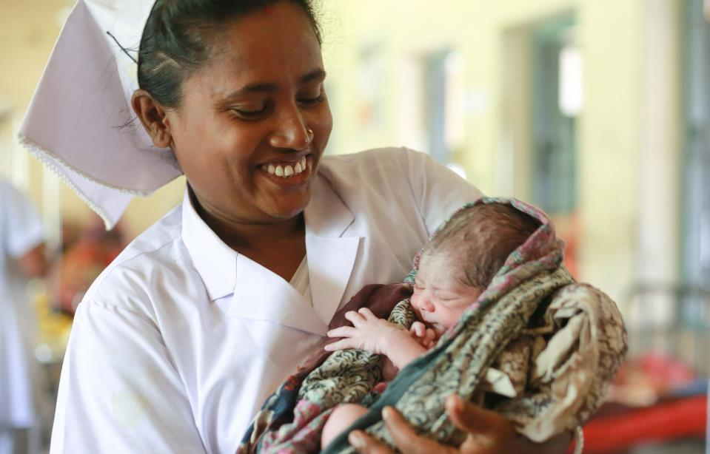



Accelerating action on WASH in health care facilities
A key lever for universal Primary Health Care
Bruce Gordon, WASH Lead, WHO Geneva
IRC All Systems Connect Conference, May 2023

Slide 13


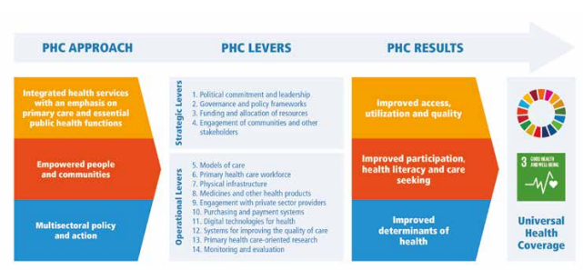
Primary health care presents an important platform and mechanism to drive progress in WASH and energy in health care facilities
Renewed interest and collaborative approach to PHC (40 years post Alma-Ata 1978; 2019 WHA resolution on PHC)
Physical infrastructure (WASH, energy) one of 10 operational levers
In countries like Indonesia and Philippines, improvements in climate resilient WASH and energy, are used a drivers and indicators of progress to achieve national PHC goals and benchmarks (e.g. Indonesia aims to achieve universal basic WASH in 9,000 PHC by 2025).

Slide 14










“Do not call it a health care facility if there is no water, sanitation, hygiene or electricity.”
Globally, major coverage gaps persist
1 in 4 HCFs lacks basic water—facilities serving 1.7 Billion people
1 in 10 has no sanitation—780 million people use facilities without toilets
1 in 2 lacks basic hand hygiene (at points of care and toilets)
2 in 5 lack basic waste services (segregation + treatment)
1 billion served by facilities without reliable energy
Source: Progress on WASH in Health Care Facilities 2000-2021: Focus on WASH and IPC (WHO/UNICEF, 2022); Energizing health: accelerating electricity access in health-care facilities (WHO, 2023)
Notes:
Skip for Nov meeting

Slide 15
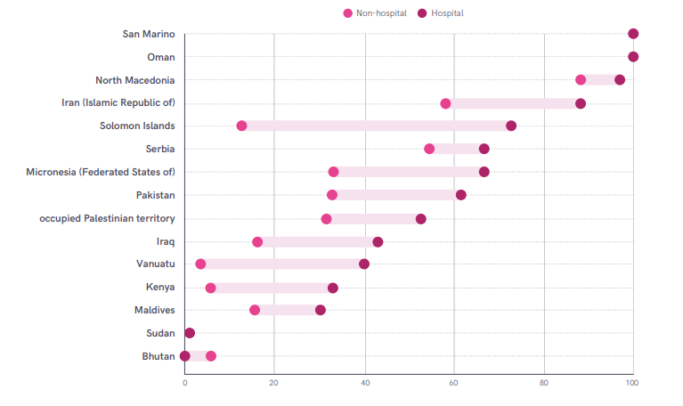
Large inequities; including between hospitals and primary care facilities
Cleaning services worse in primary care facilities, regardless of the country income level.

Slide 16
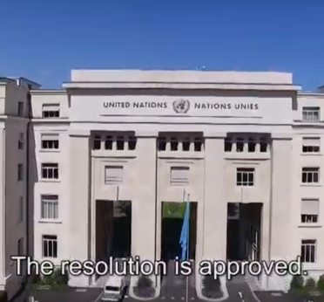
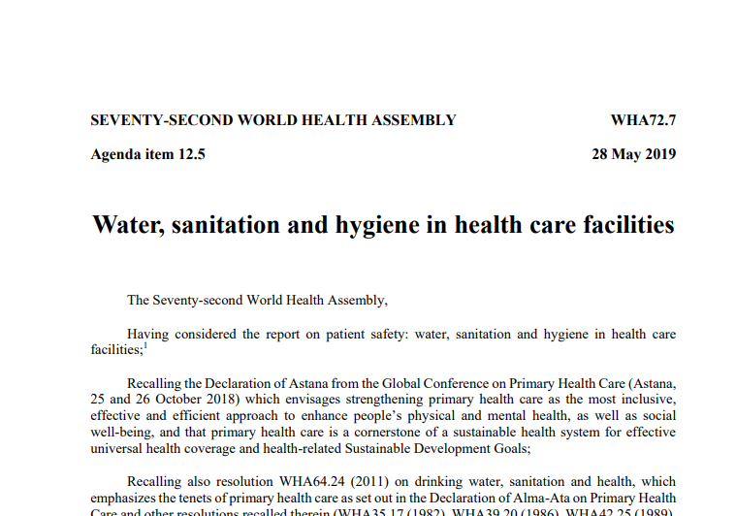
All countries committed to greater investments and action for WASH in health care facilities: World Health Assembly Resolution 72.7 (2019)
Calls for ALL Member States to:
Establish national roadmap, targets and implement WASH in HCF and infection prevention and control (IPC) standards
Integrate WASH and IPC standards and indicators into health programming and monitoring
Address inequities, especially in primary health care facilities and facilities where births occur
Increase domestic funding for WASH in HCF
Calls for the WHO Director General to:
Provide leadership, technical guidance and regularly report on status
Mobilize partners and investments
Available at
http://apps.who.int/gb/ebwha/pdf_files/WHA72/A72_R7-en.pdf
Notes:
The WHA Resolution was passed in 2019 and has the backing of ALL 194 Member States.
WHO is responsible for reporting on progress every 2 years (May 2021 and May 2023). The contents of the Resolution map to the WHO/UNICEF 2019 8 practical steps. See next slide for details of the 8 steps.

Slide 17
Achieving basic services by 2030 in the LDCs’ existing public facilities will cost an additional US$ 6.5–9.6 billion
US$ 2.9–4.8B
US$ 3.6–4.8B
more in capital investment,
equal to US$ 2.43–3.99 per capita
more in recurrent spending,
equal to US$ 2.99–3.89
per capita
Source: Chaitkin, et al., 2022. Lancet Glob Health. 2022;10(6):doi:10.1016/S2214-109X(22)00099-7.

Slide 18
Most of the investment should be channeled to rural health facilities and primary care facilities
Urban
Hospital
Rural
Non-hospital
The rural poor stand to benefit the most from improved WASH in health care facilities.
The PHC and UHC movements cannot succeed without a strong WASH foundation.
18
*Figures reflect base estimates

Slide 19

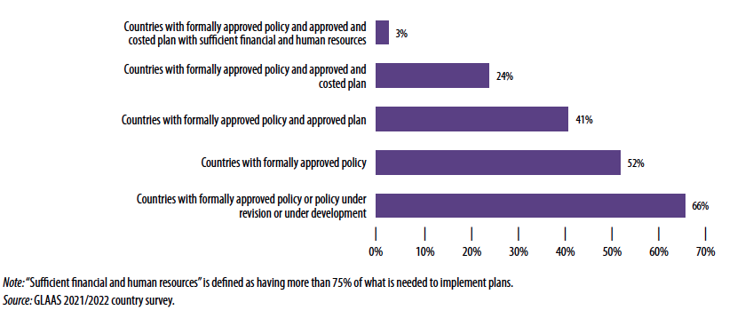
Dedicated financial and human resources for WASH in health care facilities is lacking
“Sufficient financial and human resources is defined as having more than 75% of what is needed to implement plans.”
19
Source: 2022 WHO-led UN Water Global Analysis and Assessment of Sanitation and Drinking-water

Slide 20
Costs are modest compared to WASH and health resource flows…
…and they only represent a small fraction of needed investment to provide universal basic WASH to all people in LDCs by 2030
US$ 0.54-0.79 (Cap: US$ 0.24-0.40,
O&M: US$ 0.30-0.39)
Annual investment needed per capita for WASH in HCFs in LDCs (2021–2030)
US$ 0.80
(range: US$ < 0.01–2.55)
Capital health spending per capita by 23 LDC governments
(Global Health Expenditure Database)
US$ 3.09
(range: US$ 0.01–15.72)
Annual spending per capita on WASH by 22 LDC governments
(GLAAS 2019 Report)
US$ 15.0
(range: US$ 3–900)
Recurrent health spending per capita by 44 LDC governments in 2020; similar figure for aid spending
(WHO Global Health Expenditure Database)
Needed annual investments for WASH and waste in health care facilities are 4% of current LDC government spending on health.

Slide 21
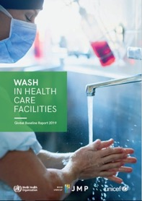
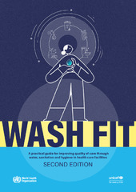
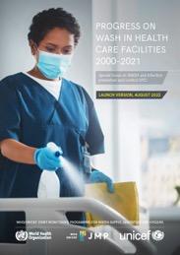


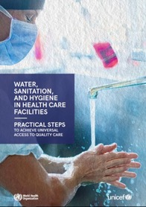

Looking ahead, 2023 – a renewed impetus & opportunity for action
Ongoing
Country implementation (75+) of standards, regular monitoring, WASH FIT, roadmaps
Global baseline and guidance form basis for strategic action, 72nd World Health Assembly Resolution
Global WASH in HCF Summit; new strategic direction set
Fundamentals First and launch of WASH in HCF Taskforce
Expanded WASH FIT V 2.0 package with focus on climate and equity
Global Progress Report/ Country tracker
21 countries met in Zambia to strengthen & catalyze further action
JMP Global update on WASH services in HCF
World Health Assembly; last reporting
April, May 2019
September 2019
December 2022
April 2022
August 2022
March 2023
May
2023
June
2023
Launch of 2023 Global Progress Report
Aim: Every user has quality care and universal WASH

Slide 22
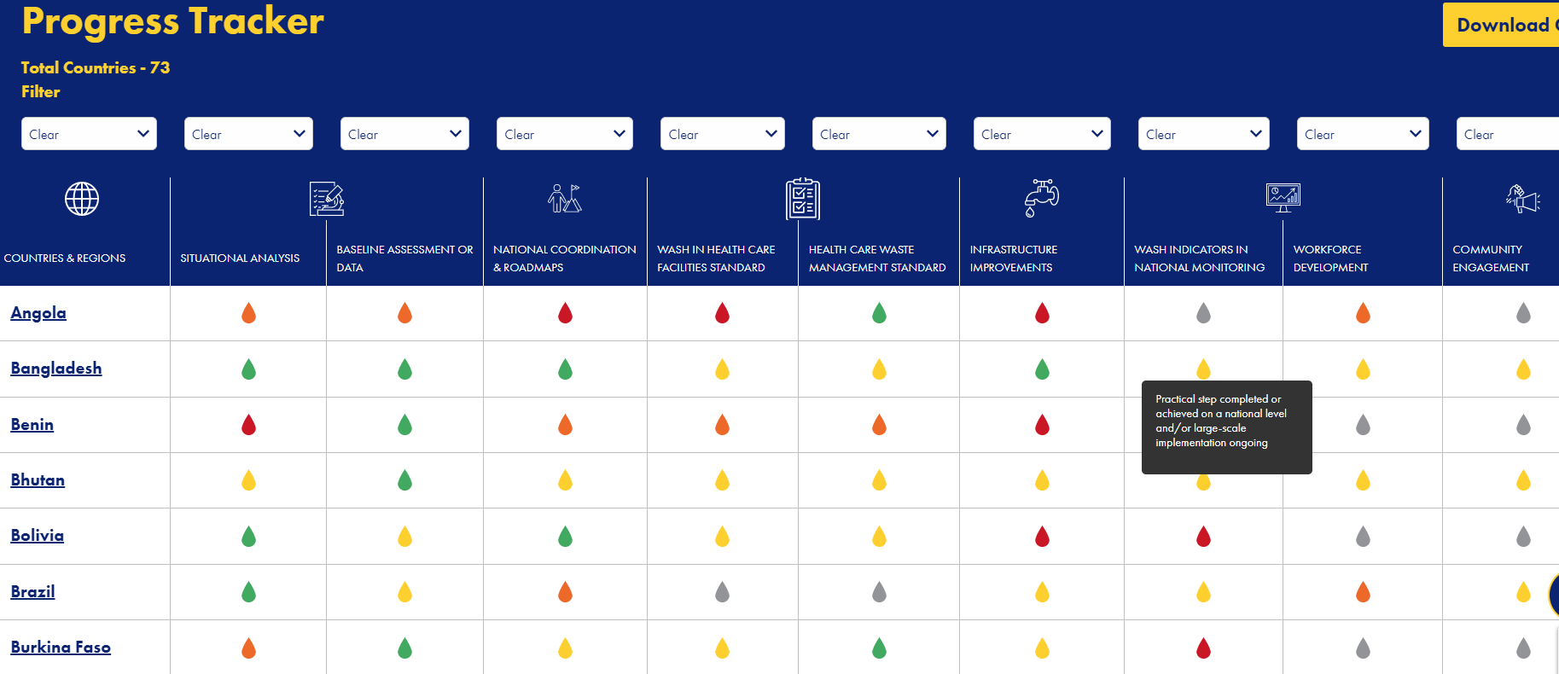
Actions needed in three main areas to accelerate progress (sneak preview-2023 global progress report)
Thank you!
Integrate WASH, waste and electricity services into health planning, programming, financing and monitoring at all levels
Regularly monitor and review progress and strengthen accountability
Develop and empower the health workforce to deliver and maintain WASH, waste and electricity services and practise good hygiene
Find out more, including progress for 73 countries, resources and new WASH FIT package at www.washinhcf.org

Slide 23
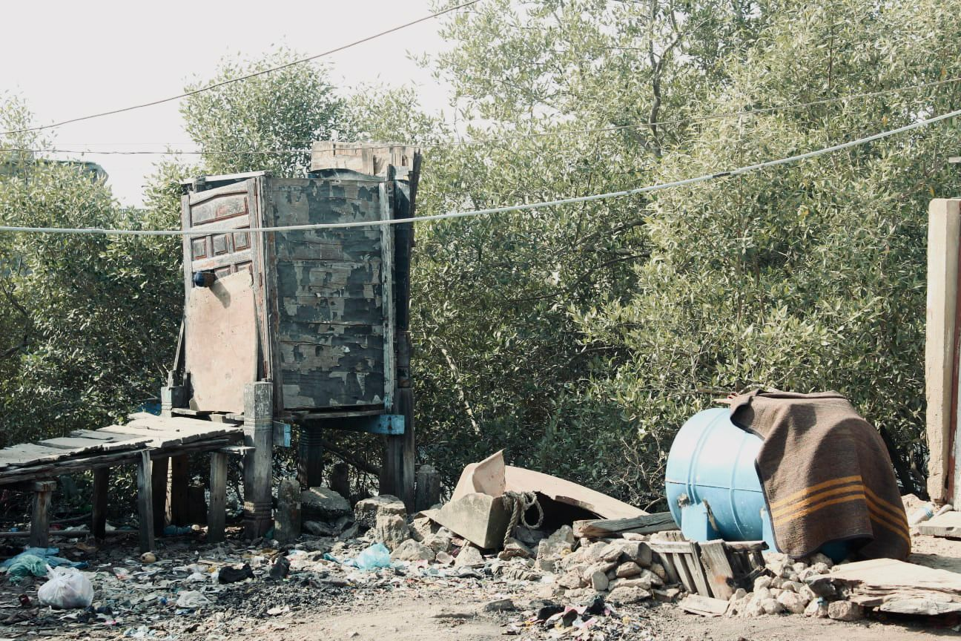

Slide 24
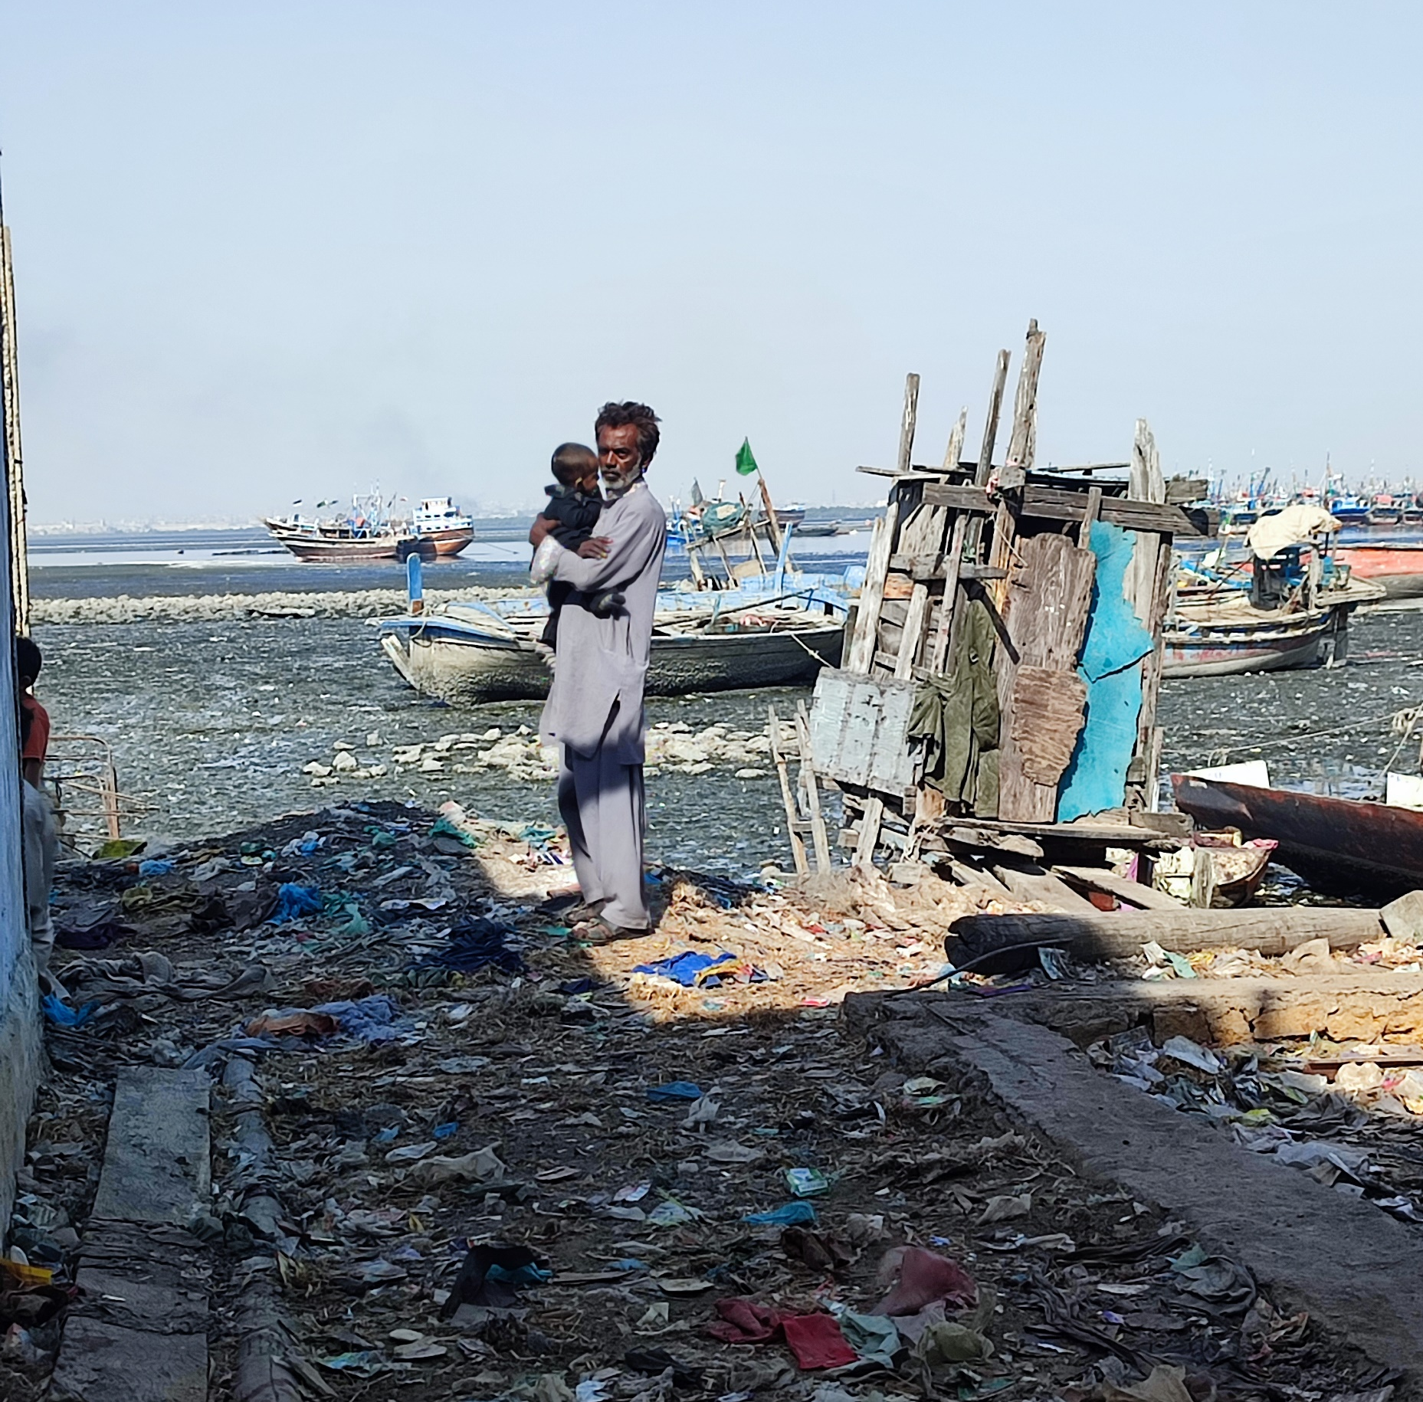
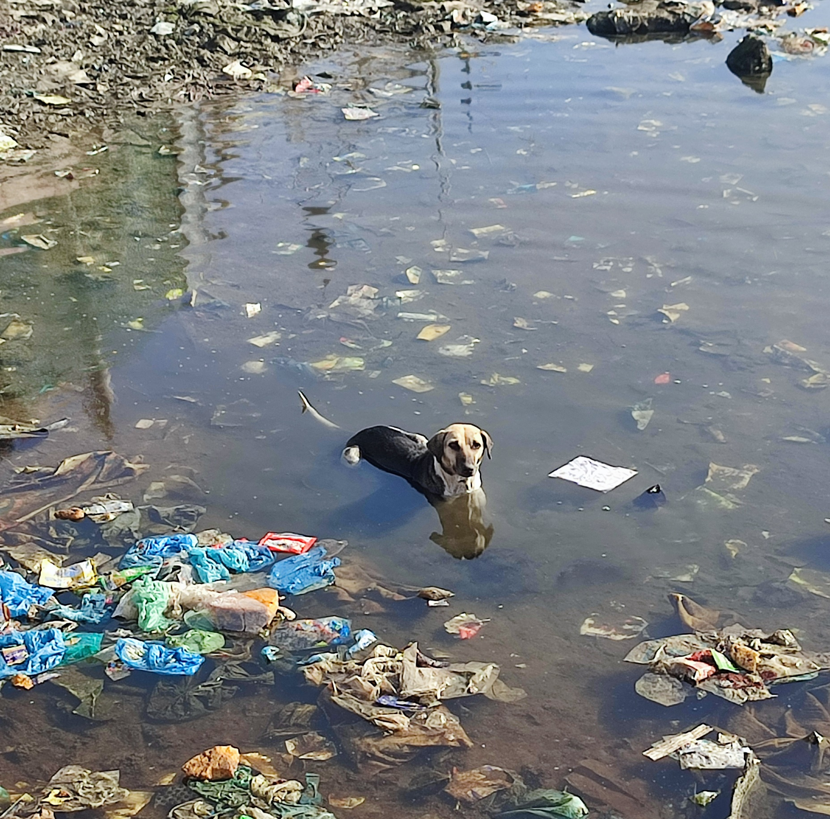
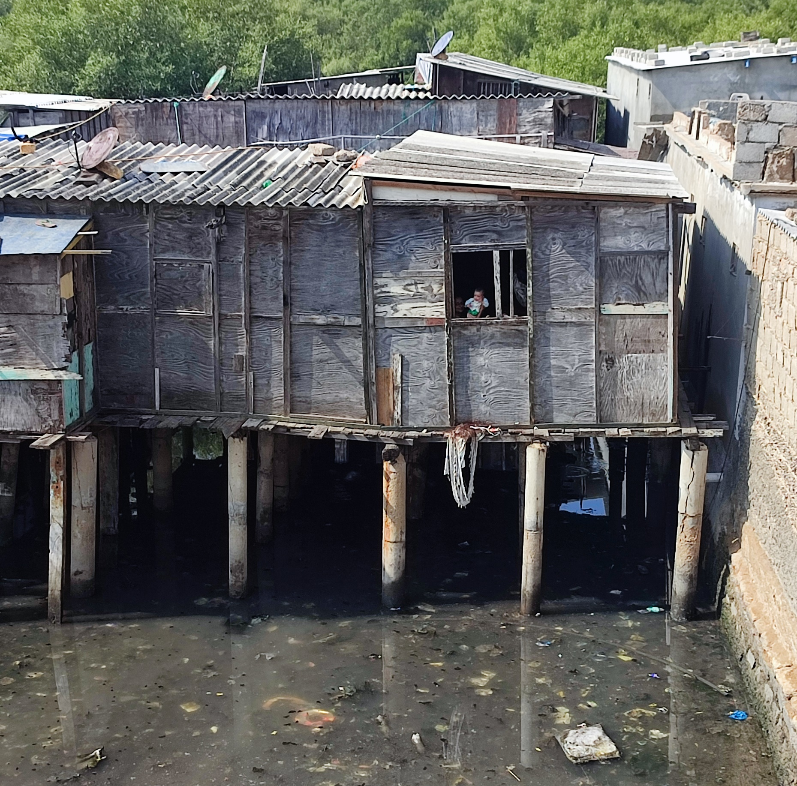

Slide 25
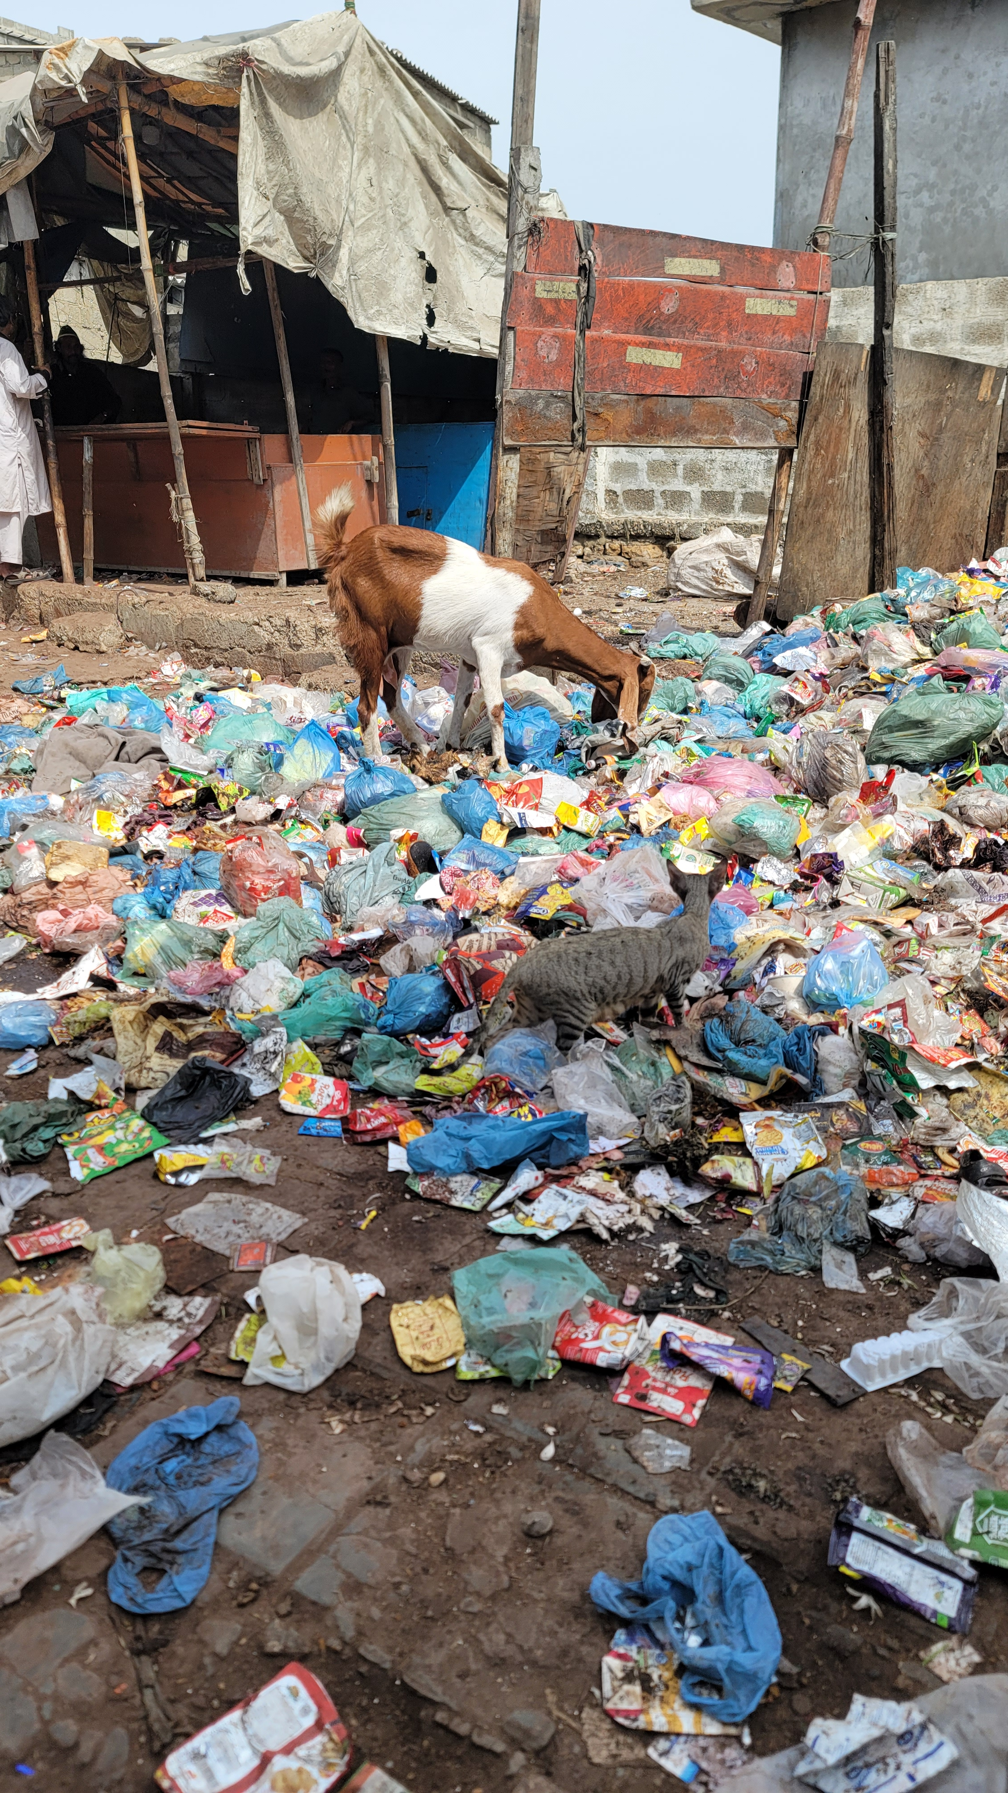

Slide 26
Section 2
Prioritisation and actions that lead to systemic and sustained change: who needs to do what in which part of the system?
World Café – Let’s chat, co-think and co-act!

Slide 27
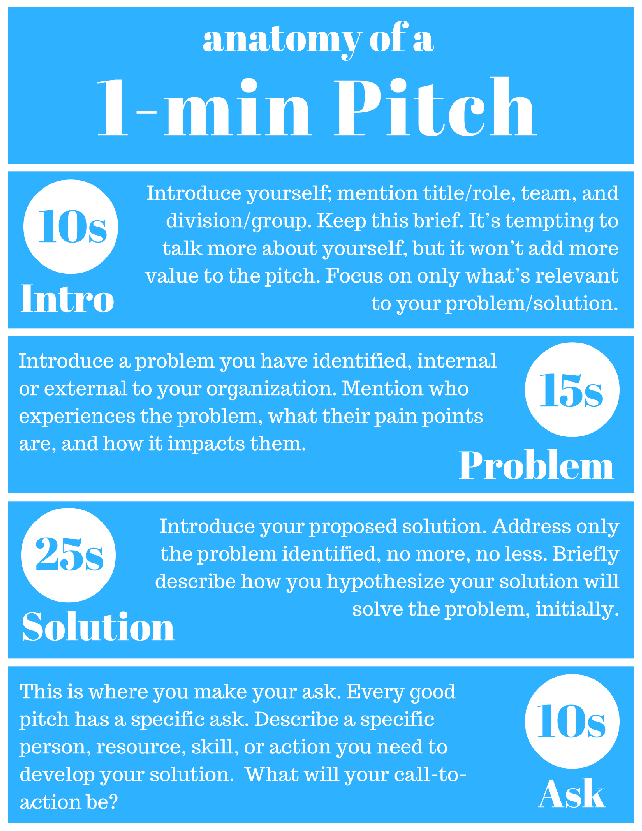
World Café discussion theme
Prioritisation and actions that lead to systemic and sustained change: Who needs to do what in which part of the system?
In groups:
Discuss
List
Prioritise
1 minute elevator pitch

Slide 28
Section 3
Prioritisation and actions that lead to systemic and sustained change: Who needs to do what in which part of the system?

Slide 29
