Slide 1


Slide 2
The Water Sector
Finance Gap
What we know and what we don’t know

Slide 3
What do we know about the finance gap?
Estimated that around US$ 200–400 billion per year of additional investments in LMICs needed just to achieve universal access to clean drinking-water, sanitation and hygiene by 2030. (OECD, 2023)
US$ 141 billion annual spending gap to meet SDG Targets 6.1 and 6.2. 2017–2030. (World Bank, 2023)
Achieving SDG 6 estimated at over US$ 1 trillion globally per year.
(WRI, 2020)
US$ 64 billion/year needs to be invested in water security to meet the Africa Water Vision 2025 and Sustainable Development Goal (SDG) targets.
(AfBD, 2021)
Notes:
FIONA
Estimates from various time periods, regions, combinations of sectors

Slide 4

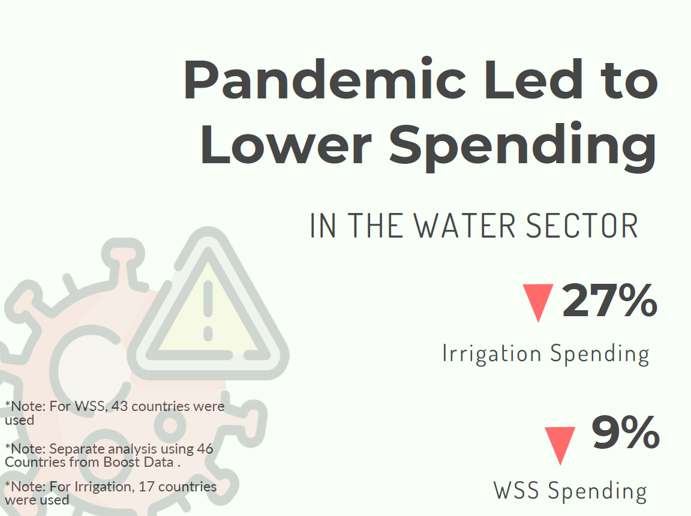
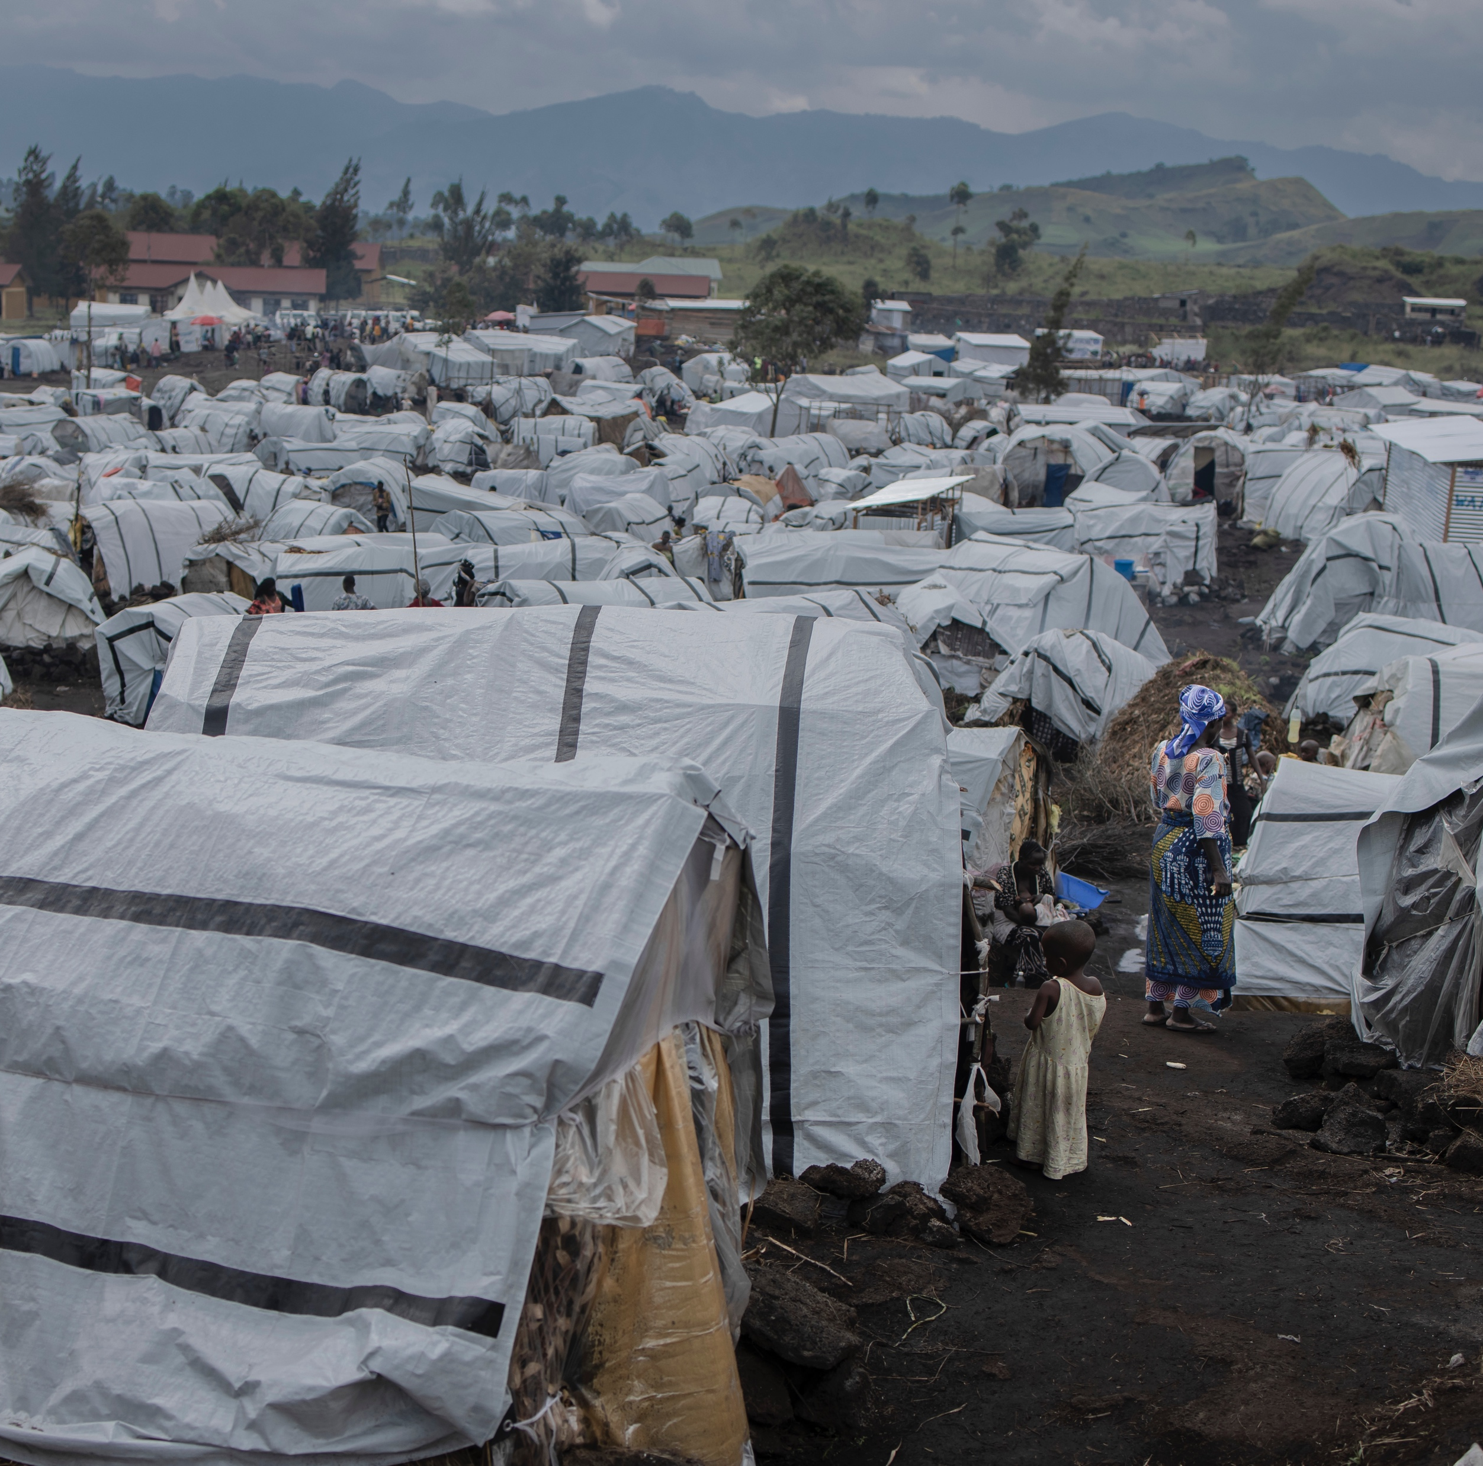
We live in a complex world
Notes:
FIONA

Slide 5


Where do we go from here?
Notes:
FIONA

Slide 6
What do we know about finance for the water sector?
Finance data on the water sector from the World Bank’s Thirsty for Change: Challenges and Opportunities in the Global Water Sector Public Spending
Notes:
BETSY
Data in the analysis from public expenditure reviews and other datasets, including OCED-CRS and IBNET.

Slide 7
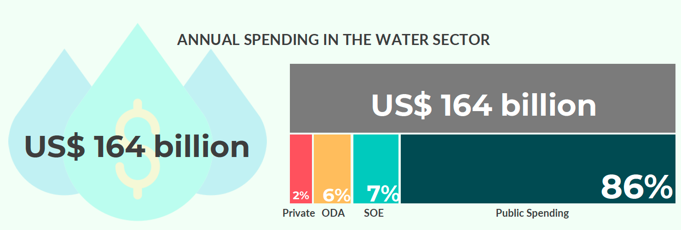
Annual spending in the water sector
Notes:
BETSY

Slide 8
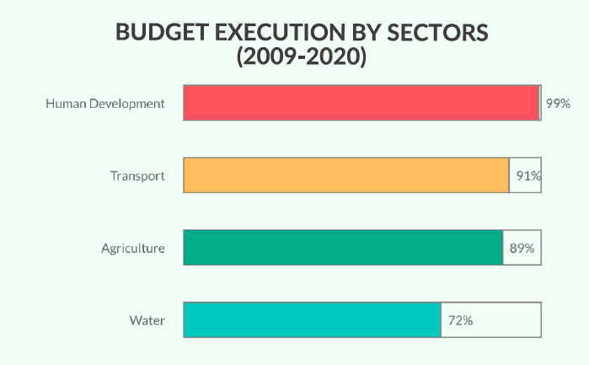
Poor budget execution in the water sector
Notes:
BETSY

Slide 9
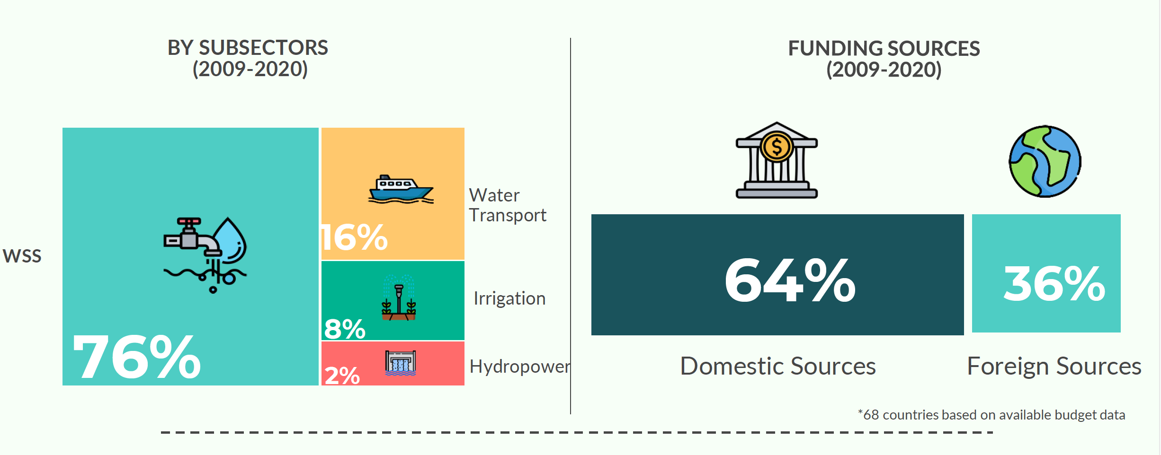
Patterns of public spending on water
Notes:
BETSY

Slide 10
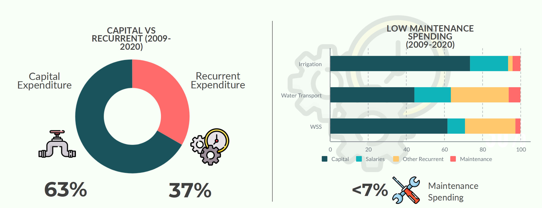
Patterns of public spending on water
Notes:
BETSY

Slide 11
What do we know about finance for water, sanitation and hygiene?
Finance data on drinking-water, sanitation and hygiene from the UN-Water Global Analysis and Assessment of Sanitation and Drinking-Water (GLAAS)
Notes:
FIONA

Slide 12
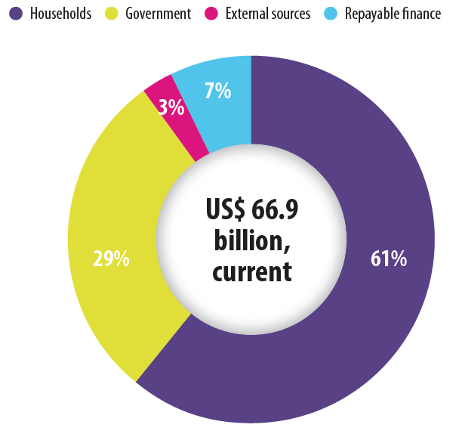
Sources of funding for WASH (n=44)
Household expenditures, through tariffs and out-of-pocket expenses, are the largest contributor to WASH spending.

Slide 13
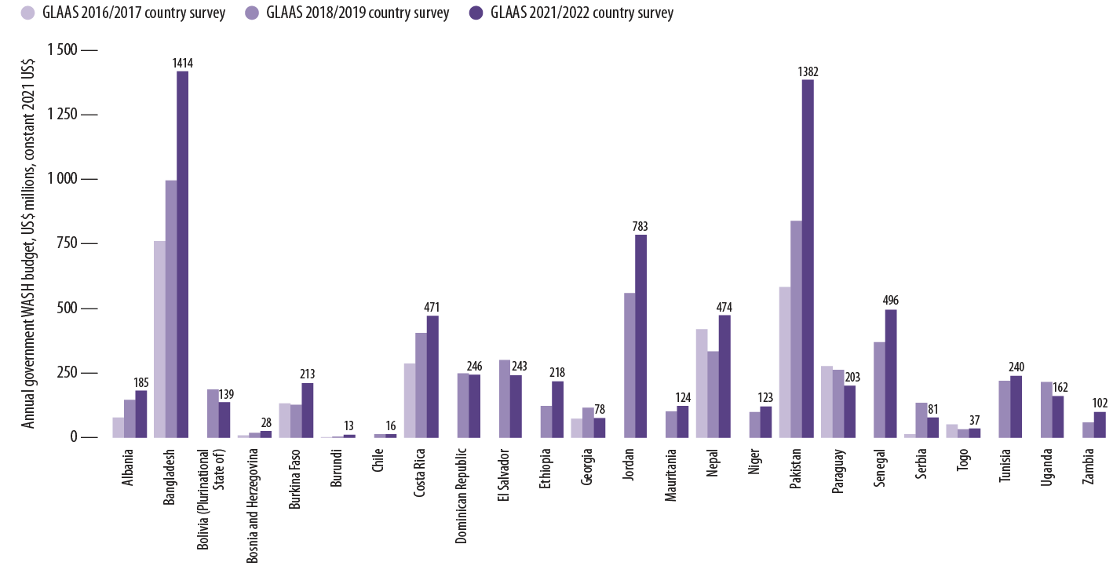

Reported government WASH budgets (US$ millions, constant 2021 US$)
Only 25 countries could provide comparable WASH budget data across the last two GLAAS cycles.
Notes:
FIONA
Analysis of those 25 countries’ budgets show that Government WASH budgets have increased at an average rate of 5% per year. Comparison between 2018/2019 cycle and 2021/2022 cycle.

Slide 14
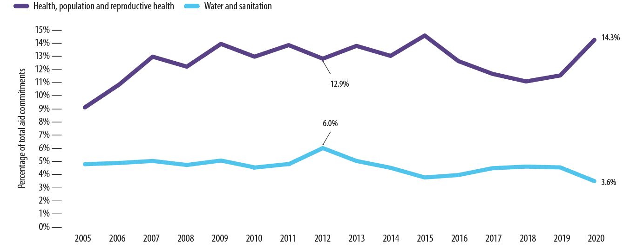
Aid commitments to water and sanitation, and to health, population and reproductive health, as a proportions of total aid
Aid for water and sanitation is decreasing.
Notes:
FIONA

Slide 15
A majority of countries report insufficient WASH funding to reach national targets.
Percentage of countries that reported insufficient funding from all sources to reach national targets
Notes:
FIONA

Slide 16
However it’s not just about the money….. but also about the strength of WASH systems.
Notes:
BETSY

Slide 17
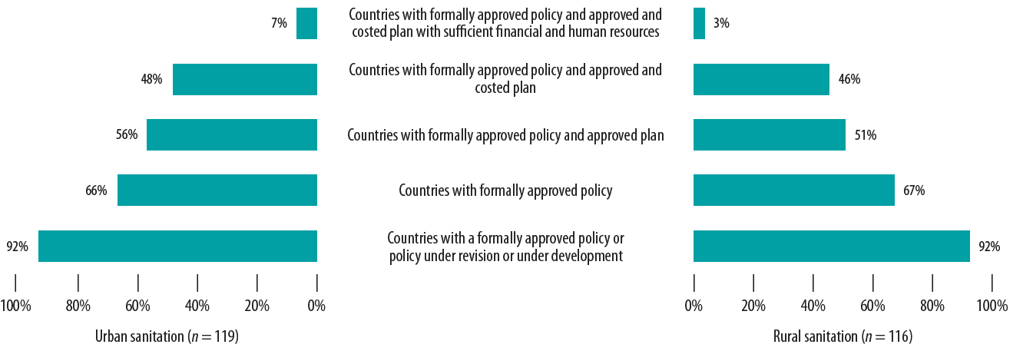
Percentage of countries that reported formally approved policies supported by resourced plans
Few countries have sufficient human and financial resources to implement policies and plans
Notes:
BETSY

Slide 18
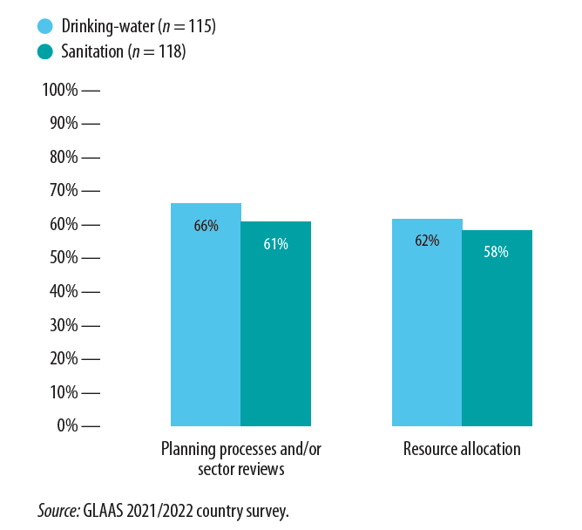
Countries are not always using data in their decision making.
Percentage of countries that reported data being used for a majority of decisions for drinking-water and sanitation
Notes:
BETSY

Slide 19
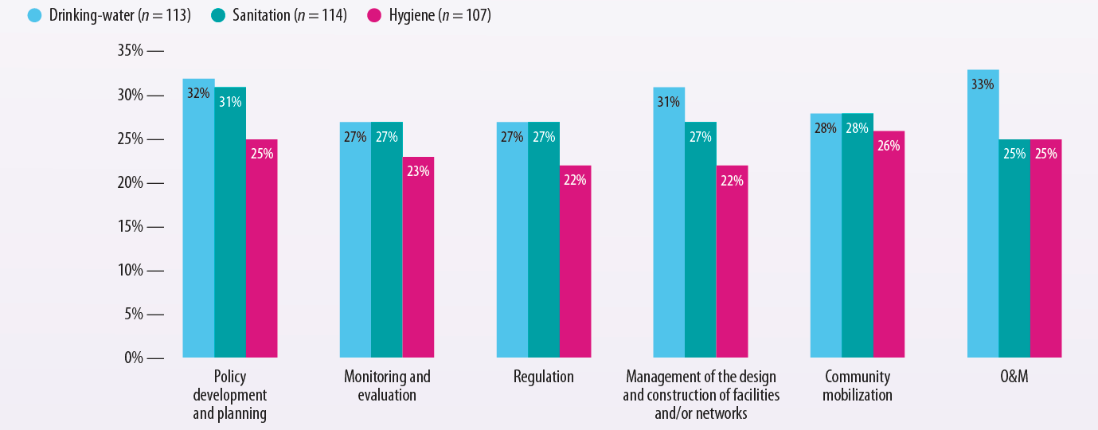
Insufficient human resources are limiting WASH service delivery.
Percentage of countries with over 75% of human resources needed for WASH functions
Notes:
BETSY

Slide 20
What can we do?
WASH accounts present a snapshot of WASH financial flows and spending in a comparable manner for a specified time period. WASH accounts are the result of mapping and analysing financial flows for WASH (WASH expenditures) based on standard classifications and terminology.
Notes:
FIONA

Slide 21
Key questions and example policy questions answered by WASH accounts
What is the total WASH expenditure?
Is current funding sufficient?
Is the total expenditure increasing or decreasing?
How does the total expenditure compare with other sectors (for example health and education)?
How does the total per capita expenditure compare to other countries?
What are WASH funds being spent on?
Is there sufficient spending on capital investment to expand access to unserved and underserved populations?
Is funding allocated to regions, areas or social groups that need it most?
Is spending sufficient on operations and maintenance to cover recurrent costs to ensure sustainable services?
Who pays for WASH services and how much do they pay?
What is the financial burden on households?
What is the share of donor spending vs. total government expenditures?
Have government and donor commitments for WASH funding been met?
Who are the main WASH service providers and how much are they spending?
Through which providers is WASH funding channelled?
What share of WASH services are provided by government agencies, NGOs and corporate providers?
Notes:
FIONA

Slide 22
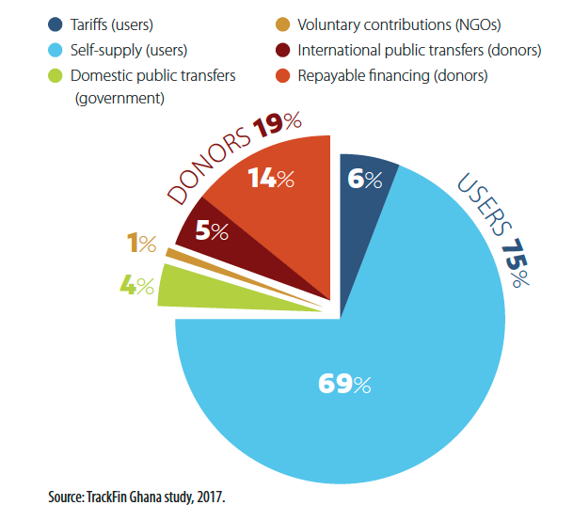
Who pays for WASH services? Example from Ghana
Notes:
FIONA

Slide 23
Data from the WASH accounts made it possible to present the real WASH finance situation to ministries and partners. Financial monitoring, which had not been done before TrackFin, is essential to understanding if adequate resources are being spent, if they correspond to planning and if they are allocated effectively.
- Malick Alhousseini
Minister of Energy and Water (2016–2018), Mali
Notes:
FIONA

Slide 24
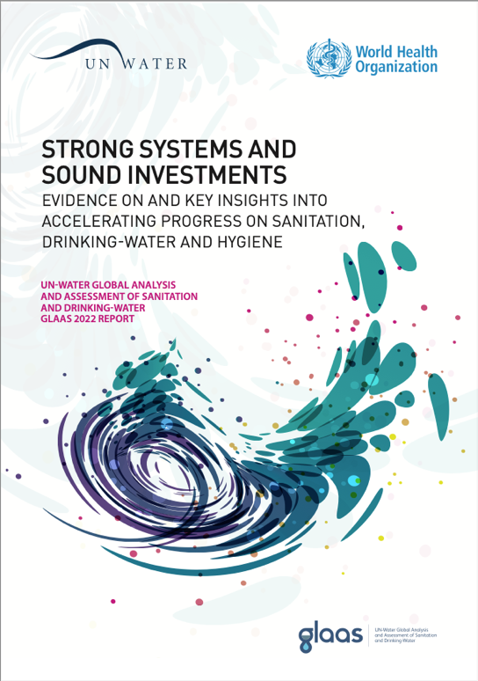
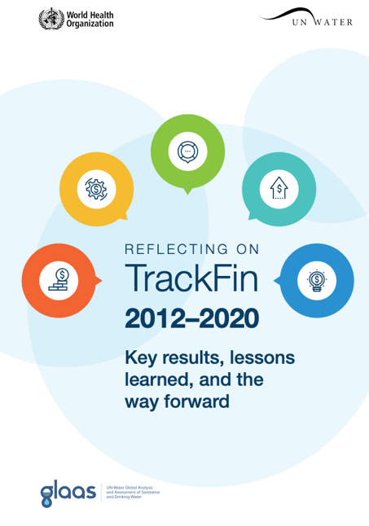
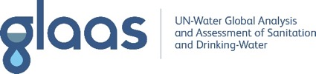



More information
GLAAS data portal: https://glaas.who.int
GLAAS 2022 report
Reflecting on TrackFin 2012–2020
Notes:
FIONA

Slide 26









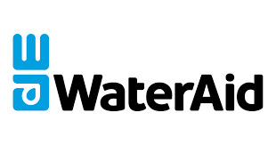







A brief history of
Development of the TrackFin methodology by WHO
Publication of the TrackFin Guidance Document
Piloting the TrackFin methodology in Brazil, Ghana and Morocco
Launch of WAPT
TrackFin Training of Trainers Workshop
Francophone Africa WAPT Workshop
Launch of optimized WASH accounts approach
New WAPT features released
South and East Asia workshop
Anglophone Africa WAPT workshop
Launch of the Central and South America cohort
Launch of the 2023 Africa cohort
2012
2013
2014
2015
2016
2017
2018
2019
2020
2021
2022
2023
1st version of the Guidance Document
Revision of methodology
Since 2014:
37 countries
have / are developing WASH accounts
13 partners
have supported the WASH accounts process
Argentina*
Bangladesh
Belize
Benin
Bolivia
Brazil*
Burkina Faso*
Chad
Chile
Costa Rica
Dominican Republic
El Salvador
Ghana*
Guatemala
Honduras
India (Rajasthan, West Bengal)
Kenya*
Kyrgyzstan
Madagascar*
Malawi
Mali*
Mauritania
Mexico*
Morocco
Mozambique
Nepal
Nicaragua
Niger
Nigeria*
Panama
Paraguay
Peru*
Senegal*
Sierra Leone
Tunisia
Uganda*
Zimbabwe
*Countries that have initiated more than one WASH accounts cycle

