Slide 1
WATER FOR ALL IN RURAL AREAS
THE UDUMA PROJECT FOR AFRICA
Thierry BARBOTTE - Christophe GUILLEMIN
12/01/2016 – DGIS - The Hague

Slide 2
THE AIM
Access to drinking water for all by 2030, SDG 6.1 of the United Nations 2030 Agenda, adopted on 27 September 2015
The UDUMA project is aimed at the 450 million people living in rural or remote areas in Africa without access to drinking water

Slide 3
THE SCALE OF THE PROBLEM: I
In Africa, 450 million people living in rural areas have no access to drinking water
Half of them are deprived of water simply because the pumps that supply their villages have broken down
The number of broken-down pumps in sub-Saharan Africa is estimated at 500,000 (of 1 million installed)

Slide 4
THE SCALE OF THE PROBLEM: II
A huge need for funding
Total funding required: US$8 billion, of which:
US$1 billion to repair broken-down pumps and cover half of the requirements
US$7 billion for new infrastructure (boreholes + pumps) to cover the other half

Slide 5
THE SOURCE OF THE PROBLEM
Lowest bidder – Shortest flow
The lack of attention paid to providing water service in invitations to tenders, which systematically favour the lowest bidder...
Results in a high breakdown rate for equipment (pumps have an average life span of three years)...
And in turn leads to public financial institutions fatigue.

Slide 6
THE AMBITION
Tackle the perception that this is a “bottomless pit” by ensuring that pumps last a similar length of time to boreholes
One response: include a guaranteed water supply requirement of at least 15 years in invitations to tender.
But this is not the only one

Slide 7
ANOTHER SOLUTION
An entirely new approach that has never been envisaged in rural areas
Water service management delegated to a private operator based on:
Sale of water service at an average price of US$1/m³
Commitment by the operator for at least 15 years
A public commitment over the same period
Guaranteed continuity of service (breakdown 72 hours max)
Defined scope (e.g. 500 pumps/225,000 inh)

Slide 8
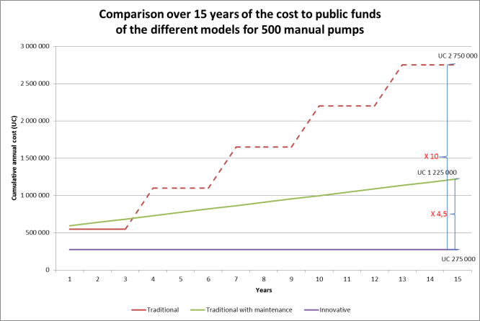
ANOTHER SOLUTION

Slide 9
THE RESULT
A tenfold increase in efficiency
A fivefold increase in durability
and
Half the grant needed
While supporting local development

Slide 10
IMPLEMENTATION CONDITIONS
A private company that is ready to commit to
A long-term public/private partnership
An innovative funding method, with
Pricing for water service
“Smart pumps”
A local intervention team and
Local governance and jobs

Slide 11
CONCLUSION
What makes the UDUMA project so innovative is the application of techniques that have proved their worth in urban environments, to remote rural areas in Africa
The solution guarantees that water needs are met over the long term

Slide 12
The boldness of the project may surprise. It needs further discussion, which we would be happy to embark on.
Mali 1976: The first Vergnet Hydro pump

